Slide 1
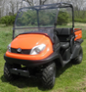

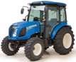
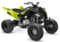
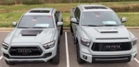

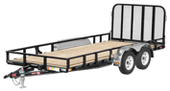
Table of Contents
UTV - Utility Task Vehicle (a.k.a. side-by-side (SxS or SSV), or ROV (Recreational Off-highway Vehicle) $8-20K
Riding Lawn Mower $3-$4K
Tractor $30-$50K
ATV - All Terrain Vehicle $8-$9K
Truck $20-50K
Minivan $50K
ATV UTV Trailer

Slide 2
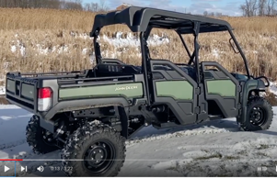
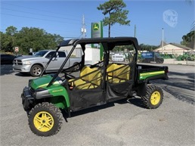
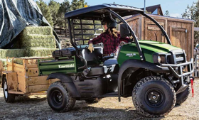

Utility Vehicle ($8-20K)
https://en.wikipedia.org/wiki/Side-by-side_(vehicle)
The side-by-side (SxS or SSV),
also called a utility task vehicle (UTV)
or recreational off-highway vehicle (ROV),
a small, 1- to 6-person four-wheel drive off-road vehicle.
Such vehicles have powertrains similar to those of ATVs (all-terrain vehicles)
John Deere XUV 825M S4 Full-Size Four Seat Gator
(30K new, 15K used)
Kawasaki MULE SX
( $8,000 )
Types of Gators - https://www.youtube.com/watch?v=cR7hSR6n83A
XUV = CUV = Crossover Utility Vehicle
Kubota RTV 520
( $10,000 )
https://www.youtube.com/watch?v=n9OXKI1Q5Xw

Slide 3
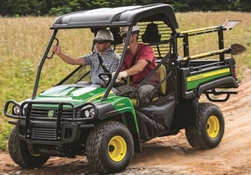
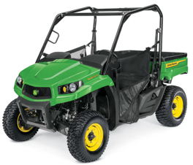
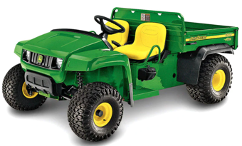

John Deere Gator Utility Vehicles
https://www.deere.com/en/gator-utility-vehicles-product-list/
HPX615E 13.7K work, traditional
cargo: 45"x52"x11", 1000 lbs
XUV590M
$15K, 4wd,
Power Steering, ...
cargo: 32.3"x56.5"x11.7"
Crossover UV, fast,
mid-size, instant 4WD, ...
TS 4x2 10.3K work, traditional
cargo 45"x12"x52"
Other models:
XUV590M s4 17K, 4wd
XUV560E s4 - 12K-14K, excellent ride, 4wd
XUV825M s4 - 20K (4 people, 4WD, PowerSteering)
HPX815E 15k3, work, diesel
XUV590E 14.4K, 32-hp, 4wd, fast (E = Economy, same as 590M, but without Power Steering)
TH 6x4 12k6 - Traditional , 6 wheels
XUV835M. 20K
(3-seat, 4WD, 4,000 tow),
cargo 45 x 12 x 52 in.

Slide 4
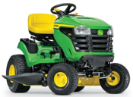
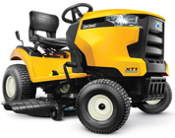
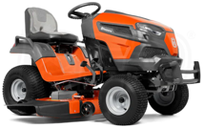
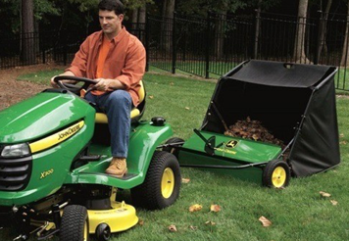
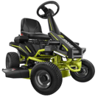
Riding Lawn Mower ($3-$4K)
https://www.familyhandyman.com/list/best-riding-lawnmowers/
John Deere S100
Gas Hydrostatic Lawn Tractor
42 in. 17.5 HP
$2,300 at Home Depot
Husqvarna TS 248XD Lawn Tractor
$3,600
cub cadet lawn mower
Husqvarna YTA24V48 and the Cub Cadet XT1 LT42
Ryobi RY48111
Electric Engine 38 inches 100 Ah Battery
$2,700 at Home Depot
John Deere Lawn Tractor
with sweeper

Slide 5
John Deere Lawn Mowers - comparison
Mullally Tractor Sales
16 miles, deliver
M-F, Sat 8-5, Sun 8-12
4510 NY-52, Jeffersonville, NY 12748
Phone: (845) 482-5222
Lindsey Equipment
27.4 miles
M-F 8-5, Sat 8-12, Sun closed
237 Sunrise Avenue, Honesdale, PA 18431
(570) 253-3334
in-store pickup only
Delaware Sport Center LLC
27.8 miles
M-F 8-5, Sat 8-2pm, Sun closed
30104 State Highway 10, Walton, NY 13856
(607) 865-8888
in-store pickup only
 | S240 | S330 | S350
Price | 3.3K | 3.8K | 4.0K
Engine | 18.5HP, v-twin cylindrical | 22HP, v-twin cylindrical | 21.5HP iTorque 2-cyl gasoline
Cutting | 42" | 42", cuts evenly | 42", cuts evenly
Frame strength and protection | average | strong | strong
Steering | 18" turning radius | 16" turning radius, very low-effort | 16" turning radius, very low-effort
Fuel tank | 9.1 liter | 12.5 liter | 12.5 liter
Main differences | Cheaper | Better for bigger area, bigger tank, better protection | Better for bigger area, bigger tank, better protection

Slide 6
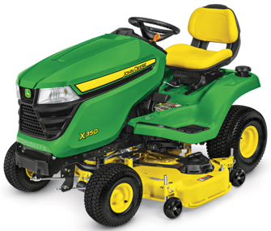
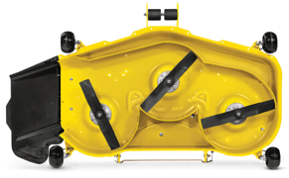
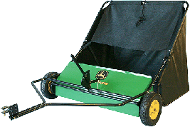

John Deere X350 Lawn Tractor with 48-inch Deck
$4,500.00
21.5-hp (16.0-kW)* iTorque™ Power System
48-in. (122 cm) Accel™ Deep Deck, MulchControl™ kit (close side door to cut grass and mulch it instead of throwing it to the side)
Twin Touch™ forward and reverse foot pedals
4 year/300 hour bumper-to-bumper warranty
X350: .. https://www.deere.com/en/mowers/lawn-tractors/x300-series/x350-lawn-tractor-48-in/
MulchControl™ Kit:
.. https://www.deere.com/en/campaigns/ag-turf/mower-decks/mulching-mower-decks/
Attachments:
.. https://www.deere.com/en/attachments-accessories-and-implements/riding-mower-attachments/
Lawn Sweeper 42" $580:
.. https://www.deere.com/en/attachments-accessories-and-implements/attachments-search-tool/#/detail/LPSTS42JD.
X350 cuts tall grass (video):
.. https://www.youtube.com/watch?v=j5_tsp1cQeI
$580.00
Mulch = a layer of (organic) material
applied to the surface of soil
Mulching = spreading a layer of (cut)
material on the ground around plants
sweeper
Accel Deep™ Mower Deck (included)
Deep draw and flat-top design
better quality of cut
at faster ground speeds

Slide 7
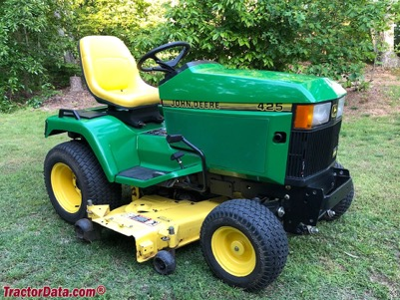
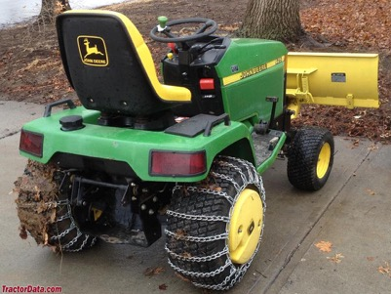
John Deere 425 (and 445)
1992 - 2001
Built in Horicon, Wisconsin, USA
Original price was $8,995 in 1995
Engine: 20HP Kawasaki 617cc 2-cyl gasoline
carburetor
(model 445 has 22 hp and fuel injection)
Fuel tank: 6.5 gal
Transmission: hydrostatic
Two-wheel drive, differential lock (mechanical rear)
Power Steering
425 Serial Numbers
https://www.tractordata.com/lawn-tractors/000/0/4/43-john-deere-425.html
Year. First tractor
1993 010001
1994 020001
1995 030001 M00425A-036065
1996 040001
1997 050001
1998 060001
1999 070001
2000 080001
2001 090001

Slide 8
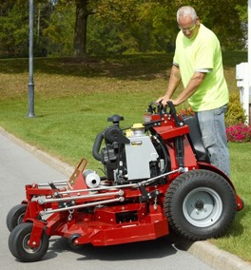
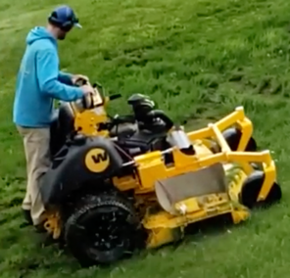
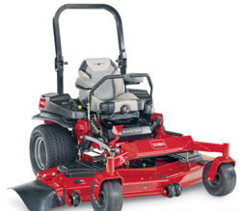
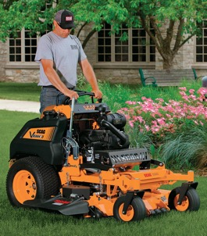
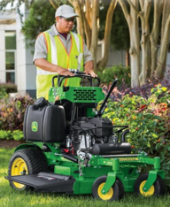
Pro Mowers
Top 3 Stand On Mowers: 1. Ferris Z3X
2. Wright ZK
3. Scag V-Ride II
TORO Z-MASTER (38 hp) – $17K
https://www.toro.com/en/professional-contractor/commercial-mowers/6000-series-60-38-hp-999cc-horizon-technology-72946
https://www.youtube.com/watch?v=eQMdzvXnxpg
Ferris Z3X (37hp, 61") - $12K
Wright ZK (37hp, 61") - $16K price
model WSZK61S61E8E-49S
https://www.wrightmfg.com/download/sales/pricing/Wright_Power_MSRP_2023_Rev02_2022_06_22a.pdf
John Deere 648R Quiktrak (22hp) – $10K
Scag V-Ride II (37hp, 61") - $11K

Slide 9
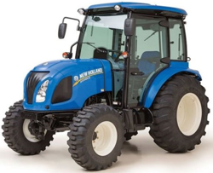
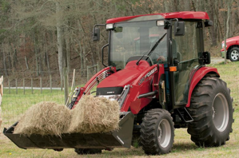
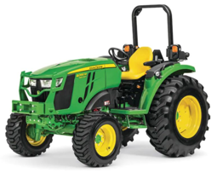
Tractor $30-$50K
https://www.tractor.com/news/5-of-the-best-compact-tractor-choices/

Slide 10
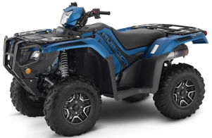

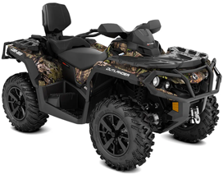
All Terrain Vehicle (ATV). ( $8-$9K )
Honda Fourtrax Foreman Rubicon 520 DCT Deluxe
Polaris Sportsman XP 1000 Ride Command
Yamaha Raptor 700R
Can-Am Outlander MAX XT
CFMoto CForce 1000 Overland
One Response
Honda Fourtrax Foreman Rubicon 520 DCT Deluxe
Yamaha Raptor 700R
Can-Am Outlander MAX XT

Slide 11
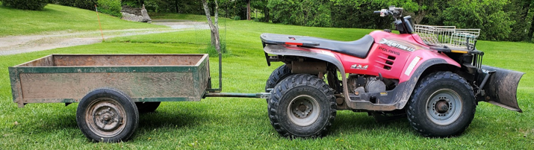
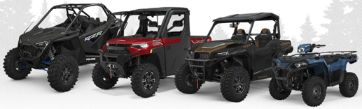




Previous owner had 20-y.old Polaris
Polaris Xpedition 425 (years 2000-2002)
price new - $6K+, price today - $1.4K
27 HP
modern off-road Polaris
https://offroad.polaris.com/en-us/
with trailer and plow
33 HP
90 HP

Slide 12
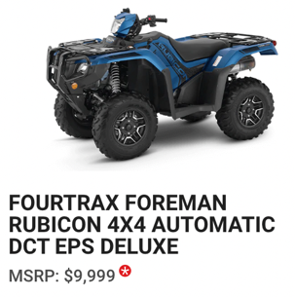
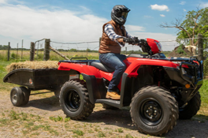

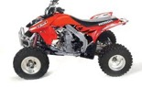
Honda is the most reliable ATV
Which ATV Is Most Reliable? Brand Comparison .. https://atvhelper.com/which-atv-is-most-reliable-brand-comparison/#
Honda ATVs since 1970, reputation for performance and reliability.
Bomb-proof transmission, metal gears, very durable, can take lots of abuse.
Multiple models (utility):
Rancher – smallest, doesn't lock 4 wheels (not good for snow pushing).
Foreman - good
Foreman Rubicon – has DCT (auto-transmission)
DCT (Dual-Clutch Transmission == Automatic transmission)
ES (Electric-shift transmission)
EPS (Electrical Power Steering)
Build your Honda ATV:
.. https://powersports.honda.com/atv/recutility/fourtrax-foreman-4x4/build
Honda FourTrax Foreman 4x4 TRX520FM1LN (2022) MSRPrice - $7.5K
Engine - 4-stroke liquid cooled 518cc
.. https://www.youtube.com/watch?v=Bd_8UyRdxuY
Honda TRX450R (2022) – a race ATV
Engine - 39 HP, Weight – 350 lbs,
Top speed – 74 mph, MSRPrice - $6.7K

Slide 13
Dealers for zip code 12741:
===========================
RUSTY PALMER, INC.
19.5 miles away
1175 Texas Palmyra Hwy, Honesdale, PA 18431
http://rustypalmer.net/honda/
(570) 253-4507
===========================
NORTH AMERICAN WARHORSE, INC.
38.2 miles away
1000 Dunham Dr., Dunmore, PA 18512-2666
https://www.nawarhorse.com/
(570) 346-2453
===========================
MAVRIX MOTORSPORTS
44.4 miles away
21 Dunning Rd., Middletown, NY 10940-2212
https://www.mavrixmotorsports.com/
(845) 344-2453
===========================
BINGHAMTON Honda
47.5 miles away
120 E Service Hwy, Binghamton, NY 13901
https://binghamtonhonda.net/
(607) 722-7433
===========================

Slide 14



Truck – $20-50K
Toyota Tacoma Truck https://www.toyota.com/tacoma/
Toyota Tundra Hybrid Truck https://www.toyota.com/tundra/
Toyota All Electric Truck https://www.youtube.com/watch?v=ETwjPUKzGEw
Tacoma vs Tundra
Car - $50K
All Electric (2023 ?)
Toyota Sienna Minivan AWD (All Wheels Drive) 7-seater https://www.toyota.com
Toyota Sienna AWD
towing capacity 3,500 lbs
Trailer Hitch installation:
https://www.youtube.com/watch?v=GTk8iqXha7Q
Another good video: https://www.youtube.com/watch?v=Ujg61Ync2Mc

Slide 15
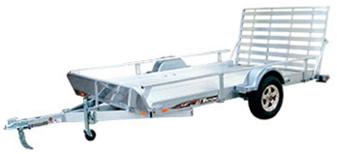
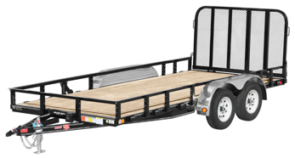
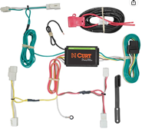
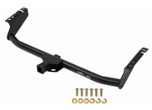
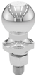
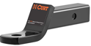
ATV UTV Trailer
2021 ATV UTV Trailer Buying Guide for 4-Wheelers and Side by Sides .. https://www.youtube.com/watch?v=CIA2vd6cUCY
PJ Channel Utility UTV ATV Landscape Trailer Comparisons .. https://www.youtube.com/watch?v=XCP5LlA0LWg
Sure-Trac Tandem Axle Utility Trailers .. https://www.youtube.com/watch?v=2GQmRGrmeKE
Trailer Hitch➔ https://amzn.to/3eHPBo8
Ball Mount➔ https://amzn.to/2xExf75
Hitch Ball➔ https://amzn.to/2RXAEVe
Wiring Harness➔ https://amzn.to/2RWvDw5
Hitch
$150
Hitch Ball Mount
$20
Ball
$10
Wiring Harness
$55

